Slide 1
PROJECT TITLE

Slide 2
EMPLOYEE DATE ANALYSIS USING EXCEL
STUDENT NAME: JEZEELA BANU.M
REGISTER NO : 312216379
DEPARTMENT : III BCOM(COMPUTER APPLICATION)
COLLEGE :SHRI SHANKARLAL SUNDARBAI SHASUN JAIN COLLEGE FOR WOMEN

Slide 3
AGENDA
1.PROBLEM STATEMENT 2.PROJECT OVERVIEW
3.END USERS
4.OUR SOLUTION AND PROPOSITION
5.DATASET DESCRIPTION
6.MODELLING APPROACH
7.RESULTS AND DISCUSSION
8.CONCLUSION

Slide 4
PROBLEM STATEMENT
In many organizations, accurately assessing employee performance is challenging due to subjective evaluation methods and inconsistent metrics. Existing performance evaluation systems often lack comprehensive, data-driven insights, making it difficult to identify performance trends, address issues effectively, and implement targeted development programs. There is a need for a systematic approach that integrates quantitative and qualitative data to provide objective, consistent, and actionable performance evaluations. This approach should enhance the ability to identify high performers, address performance gaps, and align individual contributions with organizational goals.

Slide 5
PROJECT OVERVIEW
Here is a project overview for Employee Performance Analysis in a paragraph format:The Employee Performance Analysis project aims to design and implement a comprehensive system to measure and evaluate employee performance, identifying strengths, weaknesses, and areas for improvement. Over a period of 7 weeks, the project will involve collecting and managing relevant data, developing and tracking key performance metrics, conducting statistical analysis, and providing actionable insights and recommendations. Led by a project manager and supported by a data analyst, HR representative, and IT support, the project seeks to improve employee productivity, enhance organizational performance, and inform data-driven decision making. The final deliverables will include an Employee Performance Analysis Report, a Performance Metrics Dashboard, and Recommendations for Improvement, providing stakeholders with a clear understanding of employee performance and a roadmap for future development.

Slide 6
WHO ARE THE USERS
The primary users of the Employee Performance Analysis system are HR Professionals, Line Managers, and Supervisors who will utilize the system to evaluate employee performance, identify areas for improvement, and inform decisions related to promotions, training, and development. Secondary users include Employees who will access the system to view their performance metrics, goals, and feedback, as well as Senior Leadership who will use aggregated data and insights to inform organizational strategy and decision making. Additionally, IT Support personnel will be responsible for maintaining the system and ensuring data integrity. Finally, external stakeholders such as Consultants or Coaches may also be granted access to the system to provide additional support and guidance.

Slide 7
THE WOW IN OUR SOLUTION
I see what you mean by "WOW"! Here's a possible answer:The WOW in our Employee Performance Analysis solution is:"Data-Driven Insights for Personalized Growth and Development"Our solution provides:- AI-powered performance forecasting to identify high-potential employees and areas for improvement- Real-time feedback and coaching to enhance employee growth and development- Personalized development plans tailored to individual strengths, weaknesses, and career goals- Advanced analytics and visualization to provide actionable insights and inform data-driven decisions- Intuitive and user-friendly interface for seamless navigation and engagementThis WOW factor sets our solution apart by providing a comprehensive, data-driven approach to employee performance analysis, empowering organizations to unlock the full potential of their workforce.

Slide 8
OUR SOLUTION AND ITS VALUE PROPOSITION
FILTERING -MISSING VALUES
CONDITION FORMATING -BLANK VALUES
PIVOT
TABLE CHART

Slide 9
DATASET DESCRIPTION
EMPLOYEE DATE SET –KAGGLE
26 FEATURES
FEATURES-9 FEATURES
EMP ID
GENDER -MALE, FEMALE
PERFORMANCE
BUSINESS UNIT
NAME
RATING -NUMERICAL

Slide 10
MODELLING
MODELLING
DATA COLLECTION
DATA CLEANING
TECHNIQUES
RESULTS
PIVOT TABLE
CHART GRAPHS

Slide 11
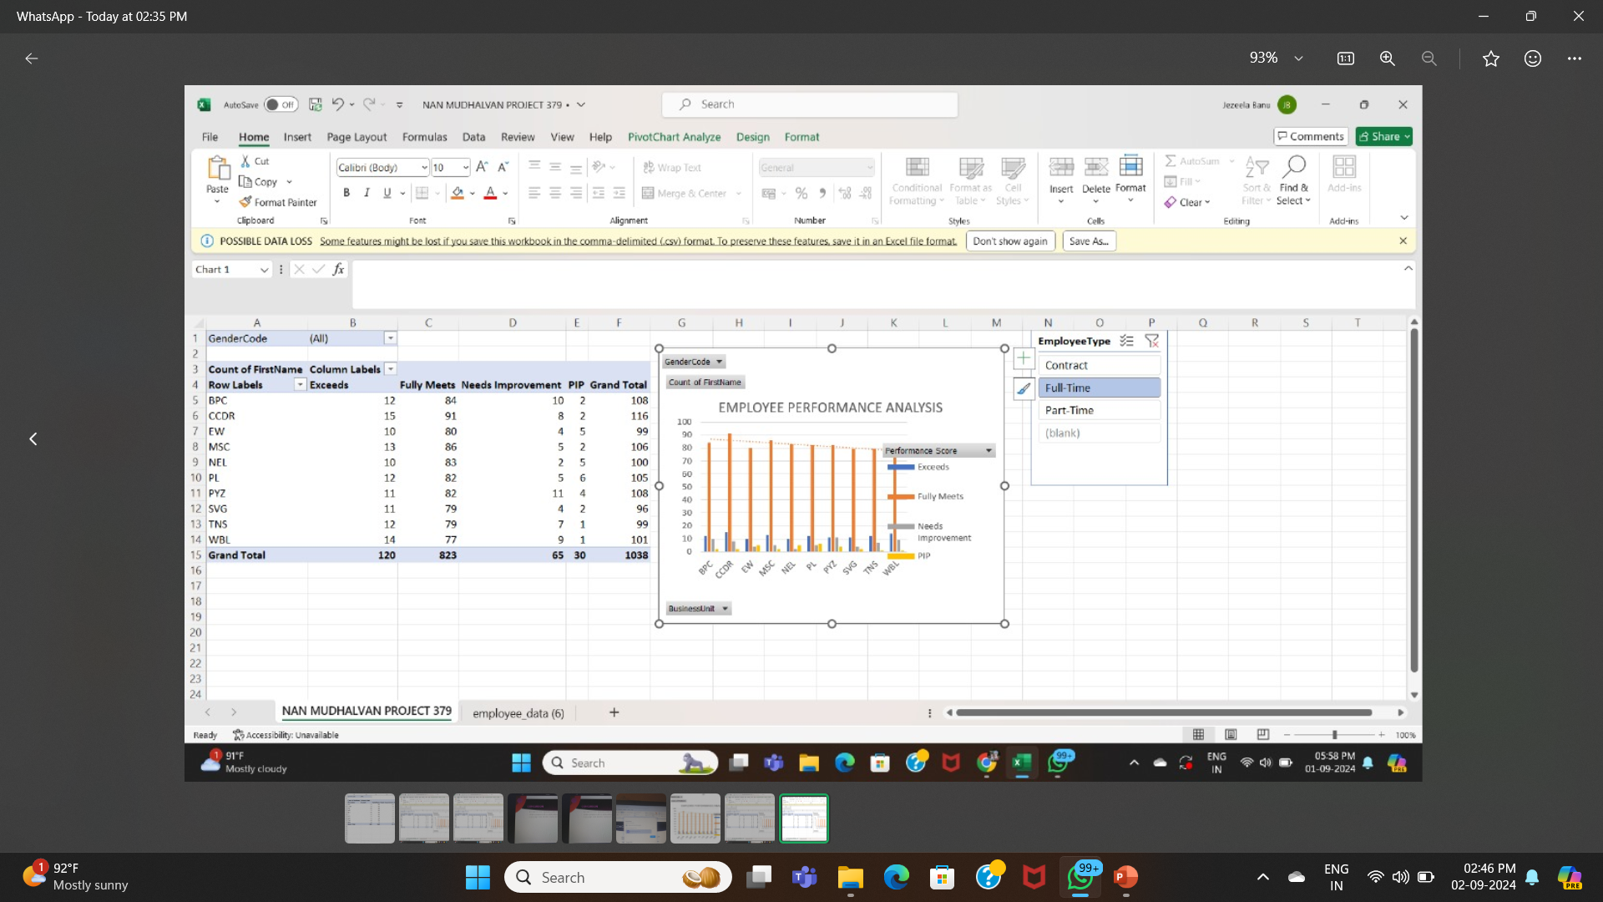
RESULT

Slide 12
CONCLUSION
Pivot table slicer shows organization performance rating scale based on business units
Gender type representation of current working left company
Employee type charts of full time part time contract

